Slide 1


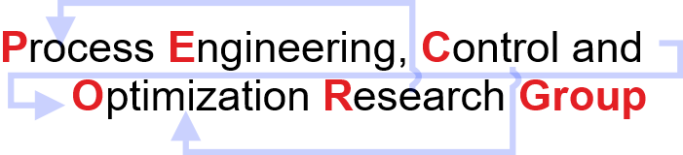
CL-699 Mid-Semester Presentation
Bilevel Programming and its Application to
Model Predictive Control
Subhi Gupta
Discipline of Chemical Engineering,
Indian Institute of Technology Gandhinagar,
Palaj, Gujarat – 382055
India

Slide 2
Content
Hierarchical order in process industry
Bilevel Programming Problem (BLPP)
Parametric Programming
Multiparametric Programming
Dual Heater Modeling of TCLab.
Bilevel Model Predictive Control
Model Predictive Control (MPC) formulation
Data-Driven State Space equations
Closed Simulation results
Conclusions and Future Work
Acknowledgement

Slide 3
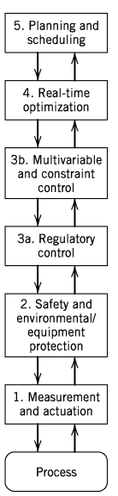
Hierarchical order in process industry
Background
Process control activities are organized in the form of hierarchy as shown in Figure 1.
For profitable plant operation the process control activities at different levels should be carefully coordinated.
Multi-level decision structures can be mathematically represented using multi-level programming principles.
Model predictive control (MPC) strategy.
Standard feedback and feedforward control techniques.
To measure process variables and implement the calculated control actions.
Figure 1: Hierarchy of process control activities
Reference: Seborg DE, Edgar TF, Mellichamp DA, Doyle III FJ.2016 Sep 13.

Slide 4
Bilevel Programming Problem (BLPP)
Motivation
In some literature, researchers have addressed bilevel decision-making problems.
Ryu et.al have taken one level as plant planning/control problem
and other level as as distribution network problem.
Styliani et.al have recasted planning and scheduling
integration as a bi-level multi-follower problem.
Upper level (planning) and lower level (scheduling).
Bilevel programming have evolved significantly in recent years.
Tri-level and other general multi-level programming problems
too are evolving gradually.
Upper-level subsystem
(Optimisation Problem 1)
Decision
connections
Information
connections
Lower-level subsystem
Controller 2 (Optimisation Problem 2)
Bilevel decision-making structure
Reference: Ryu JH, Dua V, Pistikopoulos EN. 2004 Jun 15;28(6-7):1121-9.
Reference: Avraamidou, S., & Pistikopoulos, E. N. (2018, June). IEEE.

Slide 5

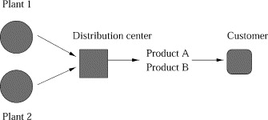





Bilevel Programming Problem (BLPP)
Bilevel Optimization Model
Leader’s problem or
High level decision problem
Follower’s problem or
Low level decision problem
Aim is to minimise both Production cost and distribution cost.
Process configuration of an enterprise
First level (production model) is constrained by another optimization problem (second level,the distribution model).
Reference: Ryu JH, Dua V, Pistikopoulos EN. 2004 Jun 15

Slide 6


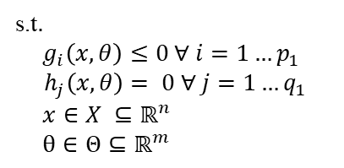
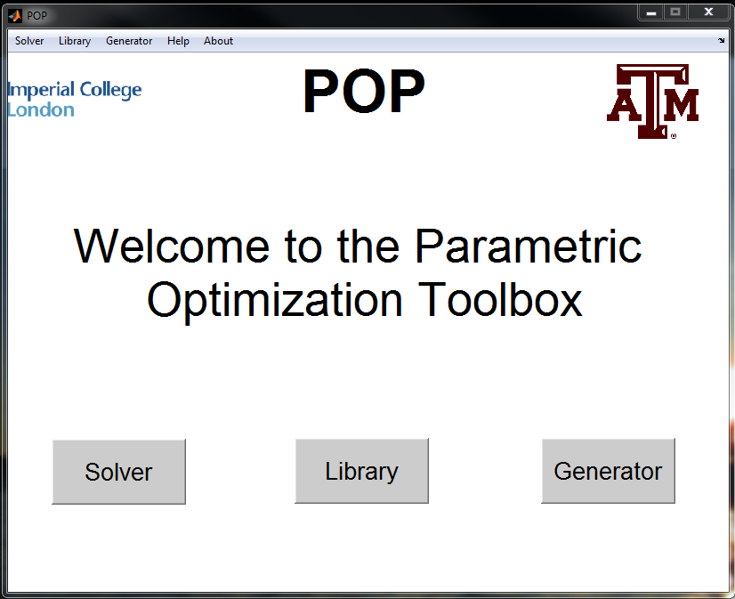
Parametric Programming
An Effective Solution Strategy
Takes into account varying parameters (𝜃).
Approach is to obtain the optimal solution (𝒙) as an explicit function of the parameters.
General parametric nonlinear programming problem
Reference: Faísca NP, Dua V, Pistikopoulos EN. 2007 Feb 9;1:1-23.
Image Source: https://parametric.tamu.edu/POP/

Slide 7
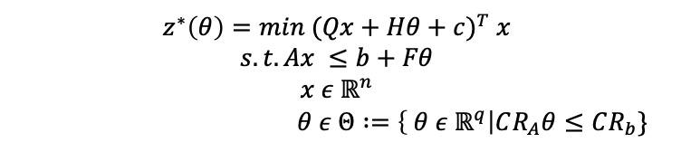
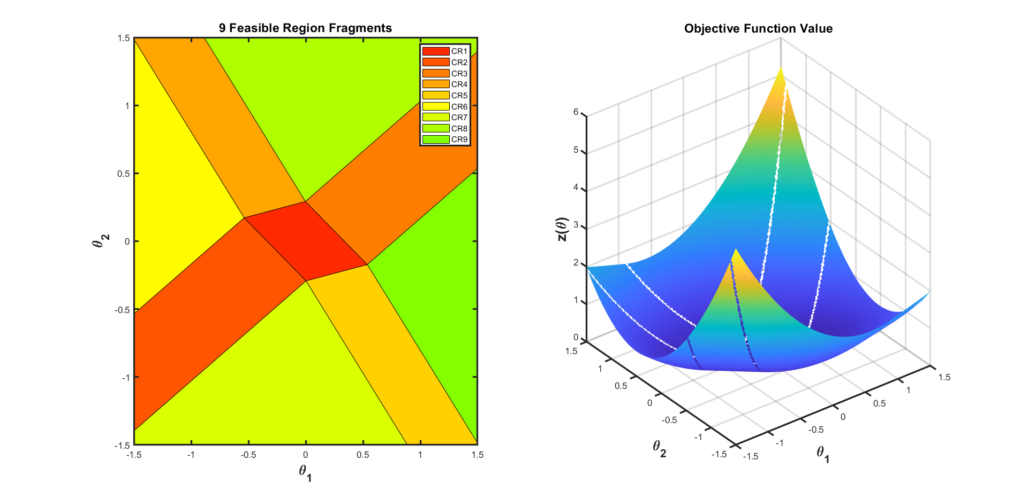
Multiparametric Programming
Formulation of Multiparametric Linear (mp-LP) and Quadratic Programming (mp-QP)
Solution of mp-QP: 𝒙(𝜃)^{𝘪}=𝑊^{𝘪}𝜃 + 𝘸 CR^{𝘪}: Φ^{𝘪}𝜃≤𝜙^{𝘪}
The parameter space(𝜃 ) is partitioned into nine set of critical regions (CR_{i}).
Each critical region has its own function optimal solution x*(𝜃 ) and Z*(𝜃 )
Verification was done using quadprog solver
Reference: Faísca NP, Dua V, Pistikopoulos EN. 2007 Feb 9;1:1-23.

Slide 8







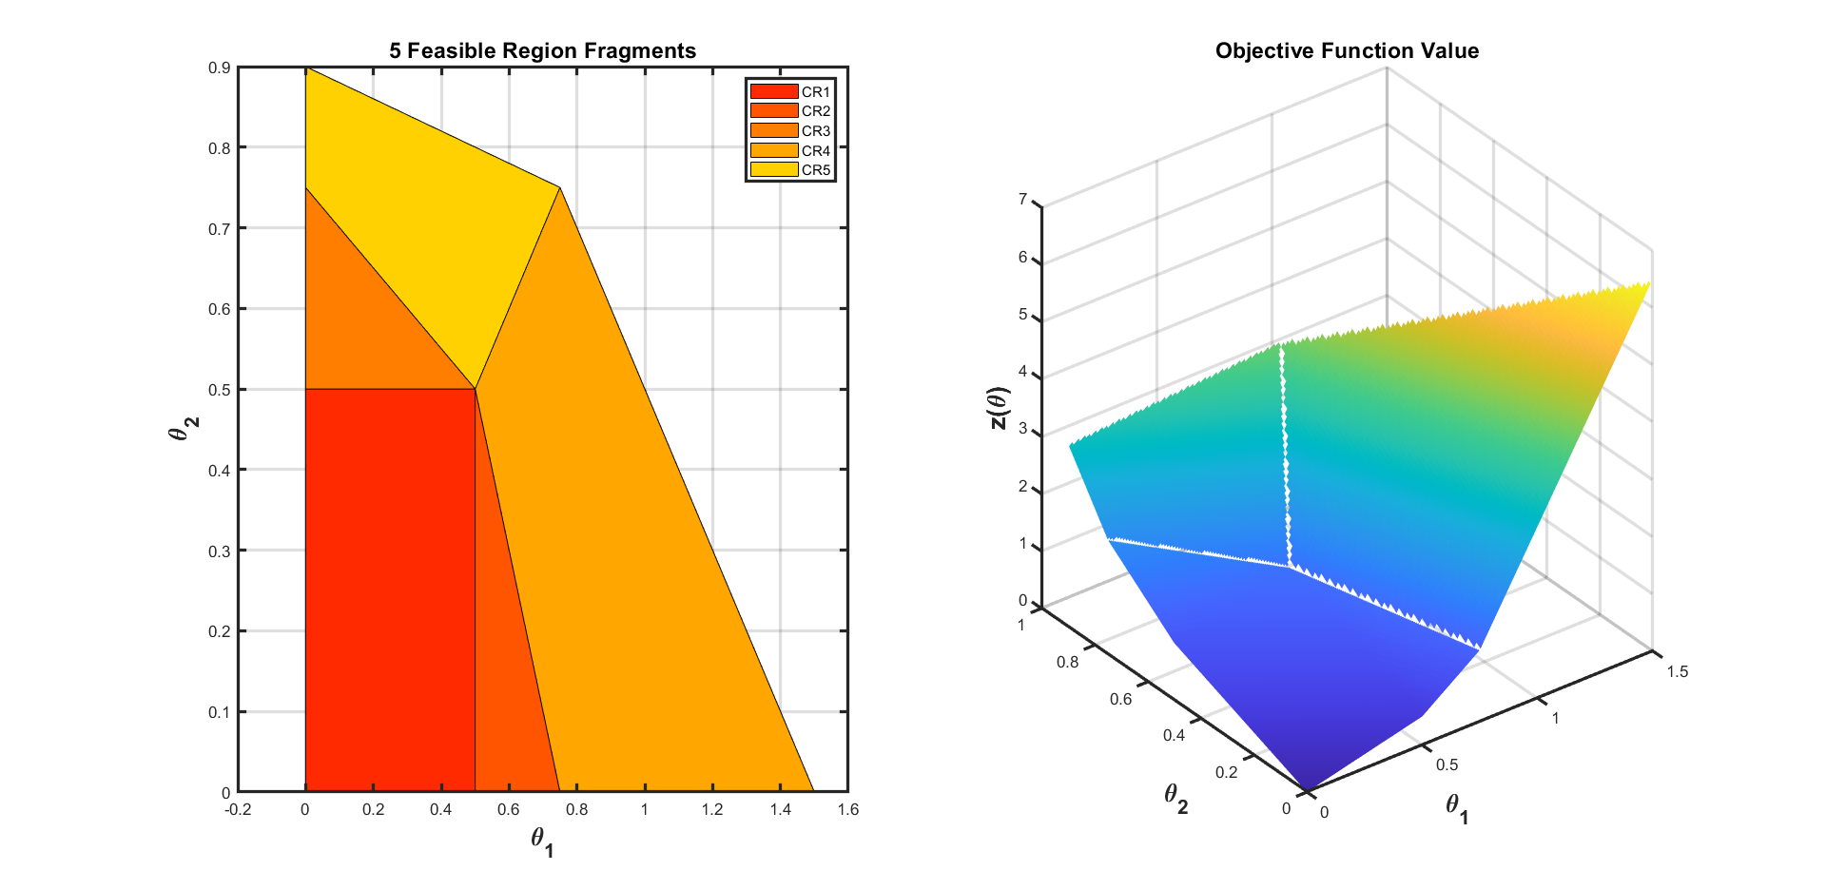
Bilevel Programming Problem (BLPP)
Formulation of Linear BLPP (LP/BLPP)
Five critical regions are obtained with y as an explicit function of x.
Inner Level solved multi-parametrically
Reference: Faísca, Nuno P., et al. Journal of Global Optimization 38.4 (2007).

Slide 9
Bilevel Programming Problem (BLPP)
Solution of a linear bilevel programming problem.
Fields | Optimised variables (𝑥) | Function values
1 | [0.5000 ; 0.5000] | -6
2 | [0.5000 ; 0.5000] | -6.0000
3 | [0 ; 0.7500] | -23.0000
4 | [0.5000 ; 0.5000] | -6.0000
5 | [0 ; 0.9000] | -26
Solution obtained after solving outer level problem
Global optimum solution

Slide 10
Bilevel Model predictive control
One of the application of Bilevel lies in hierarchical model Predictive control (MPC) structures.
In recent attempt has been made to solve MPC in hierarchical manner.
Styliani et.al in 2017 employed two level hierarchical mp-MPC on a continuous stirred tank reactor (CSTR) system.
Use of a multi-parametric bi-level algorithm for the development of explicit hierarchical controllers has limited application.
So such algorithms hold a good possibility to be explored and extended on more complex systems in near future.
Controller 1 (Optimisation Problem 1)
Controller 2 (Optimisation Problem 2)
System
Avraamidou S, Pistikopoulos EN.In Computer aided chemical engineering 2017 Jan 1.Elsevier.

Slide 11
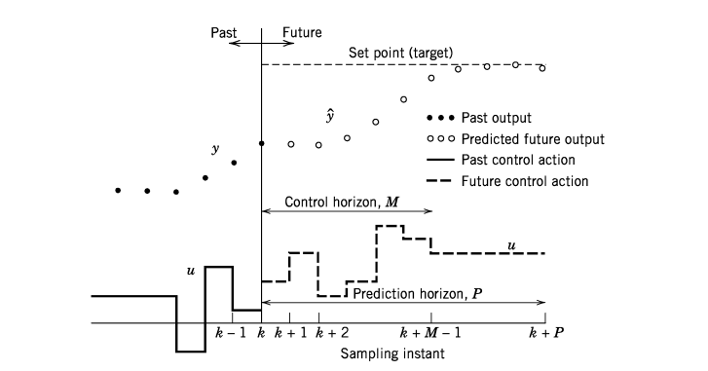
Model Predictive Control (MPC)
Basic Concept of Model Predictive Control
Current time instant
Reference 6: Seborg DE, Edgar TF, Mellichamp DA, Doyle III FJ.2016 Sep 13.

Slide 12

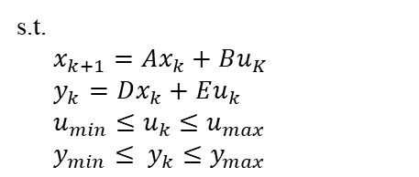
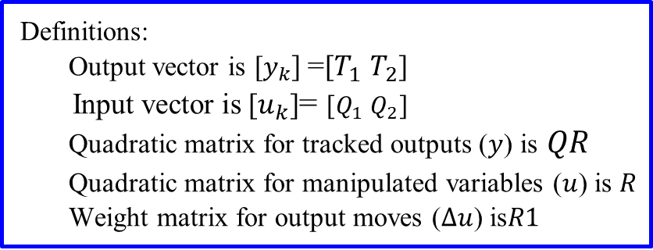
Model Predictive Control (MPC) Formulation
State space equations
MPC formulation is first reformulated into quadratic form using ss2qp_yalmip.
At each sampling instant the quadratic problem is solved using cplexqp solver.
quadprog can also be used but cplexqp gives more stable results.

Slide 13


Data Driven State Space Equations
State space equations were obtained from
MATLAB System Identification Toolbox
The state space equations used as linear constraints in MPC formulation were to be obtained first.
The differential equations representing the physical system are first linearised using MATLAB System Identification ToolBox.
Step Response Analysis method was employed on TCLab, a two heater and two sensor device (MIMO system) .

Slide 14
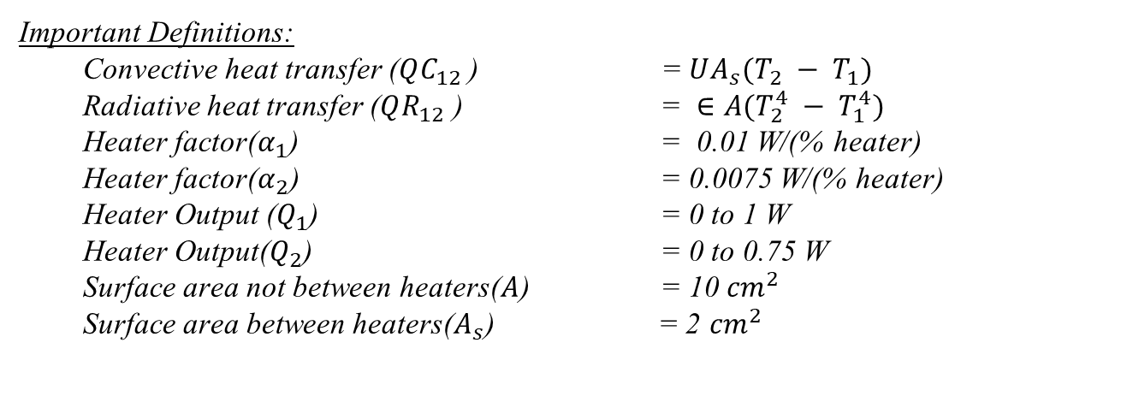
Data Driven State Space Equations
Dual Heater Modeling of TCLab (MIMO System)
Two energy balance equations that describe the dynamic temperature response

Slide 15
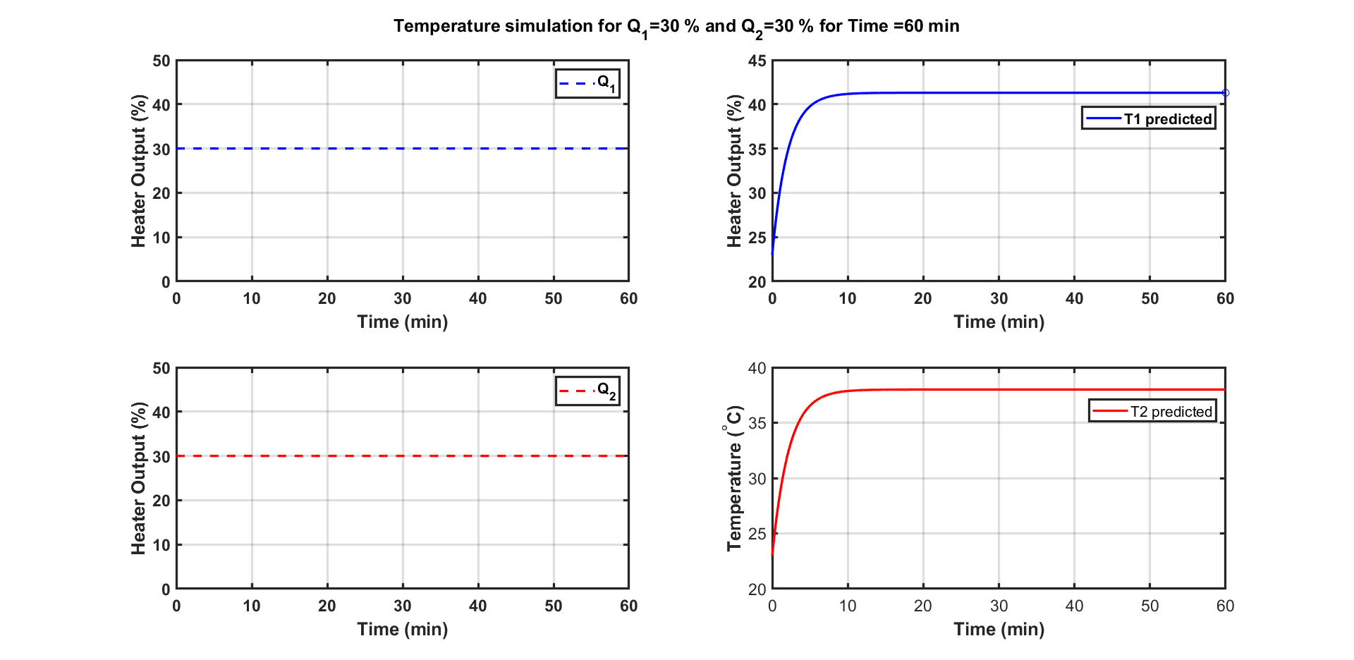
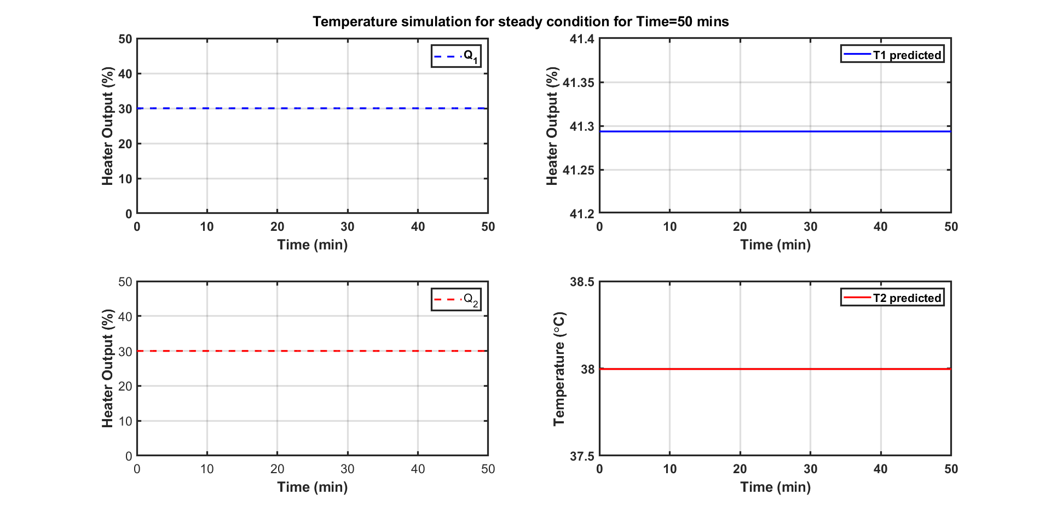
Data Driven State Space Equations
Dual Heater Modeling of TCLab (MIMO System)
Steady state achieved for Q1=30 and Q2=30
Steady state achieved for Q1=30 and Q2=30

Slide 16
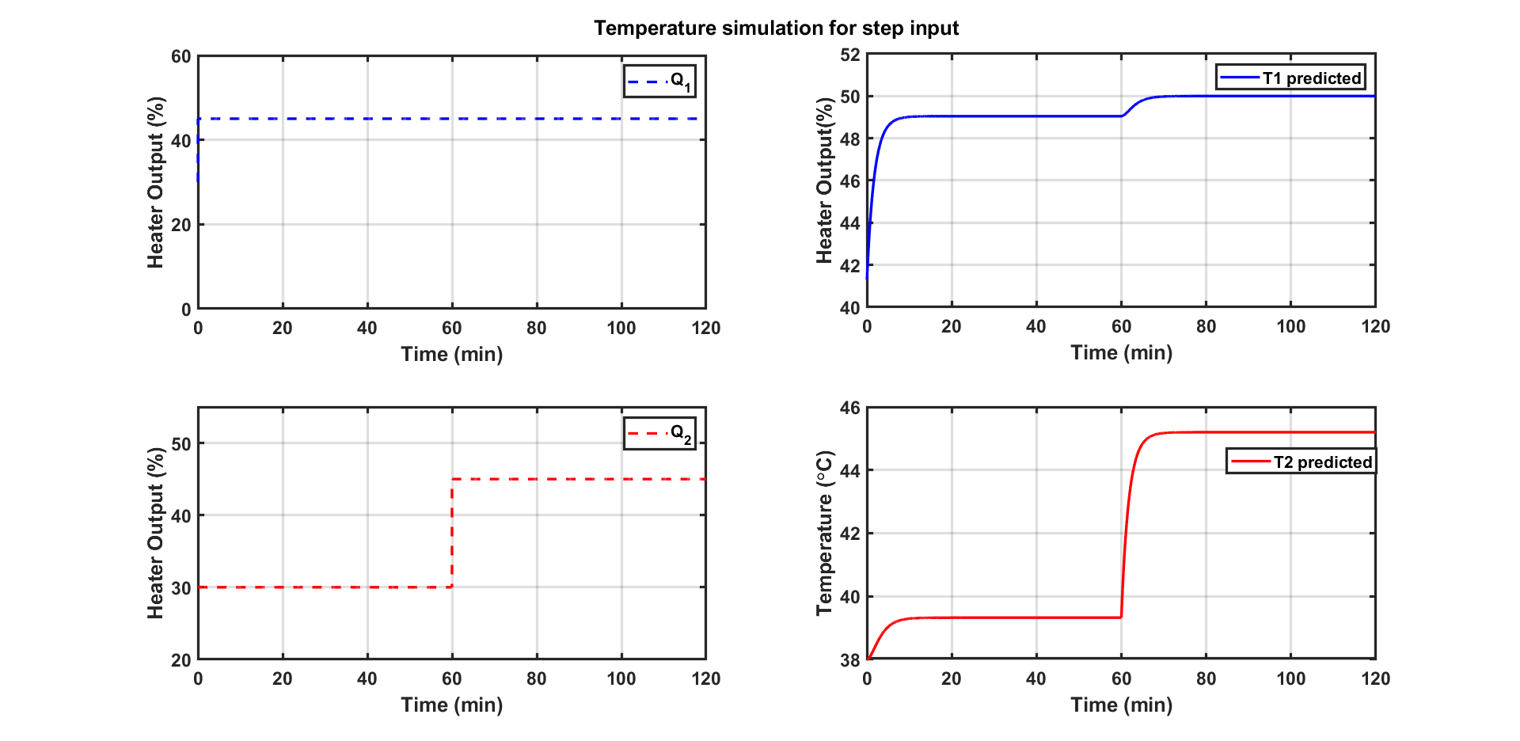
Data Driven State Space Equations
Dual Heater Modeling of TCLab (MIMO System)
Temperature simulation for step changes in Q1 and Q2
The above step response was used to develop data-driven state-space equations using System Identification Toolbox.
The resulting pseudo states equations obtained in matrix form were used as linear constraints in MPC formulation.

Slide 17
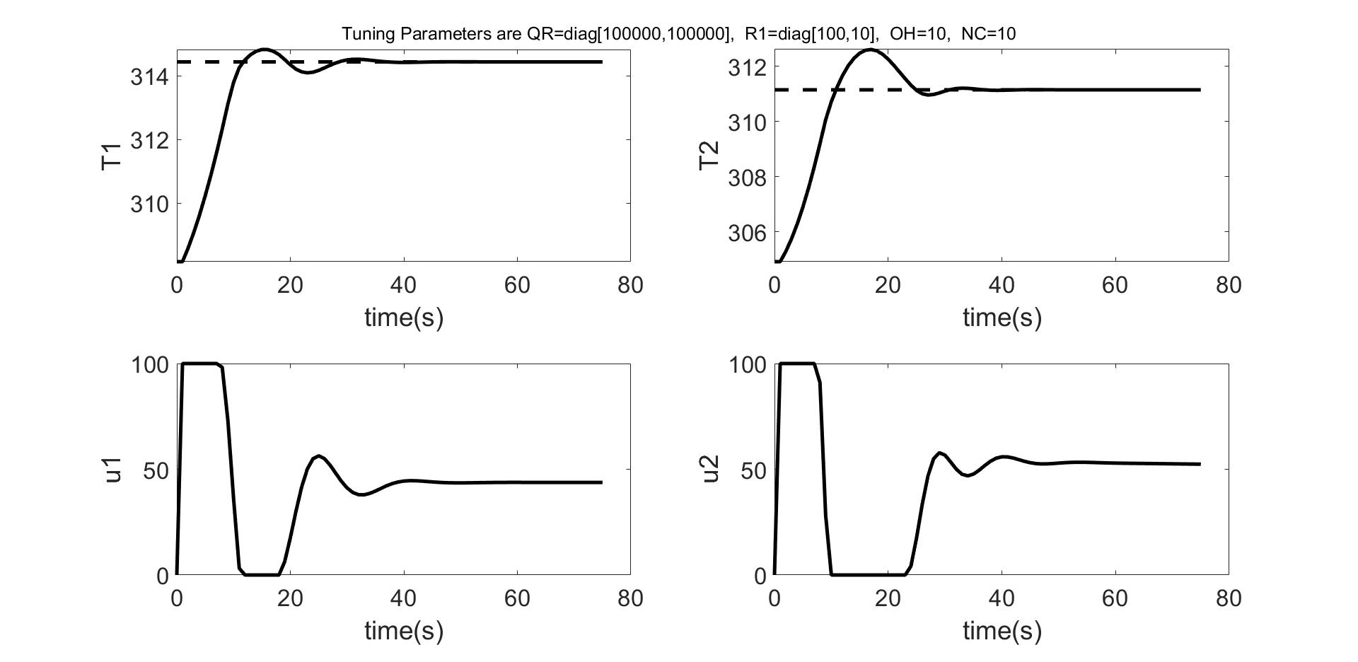
Closed-loop Simulation results.
Demonstration of MPC Control Calculations & Design and Tuning of Parameters
Best Case of Tuning Parameters
Next Task
MPC formulation was solved multi-parametrically (mp-MPC).
The idea was to confirm that the solution obtained were identical with that of MPC technique.

Slide 18
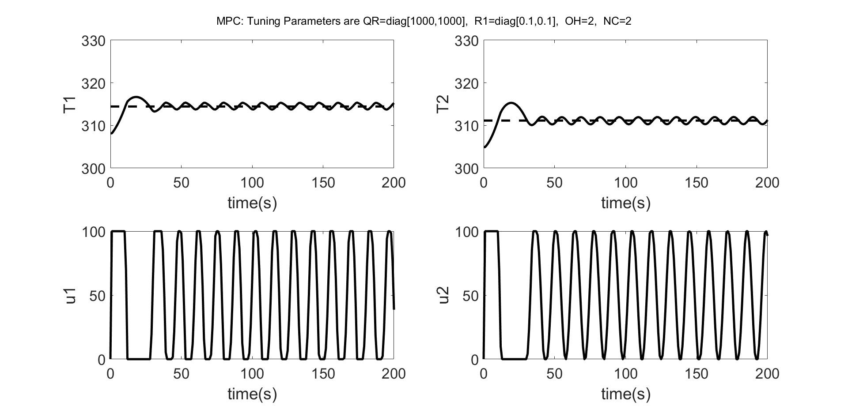

Closed Loop Simulation Results
Online MPC
mp-MPC
Online MPC and mp-MPC results match.

Slide 19
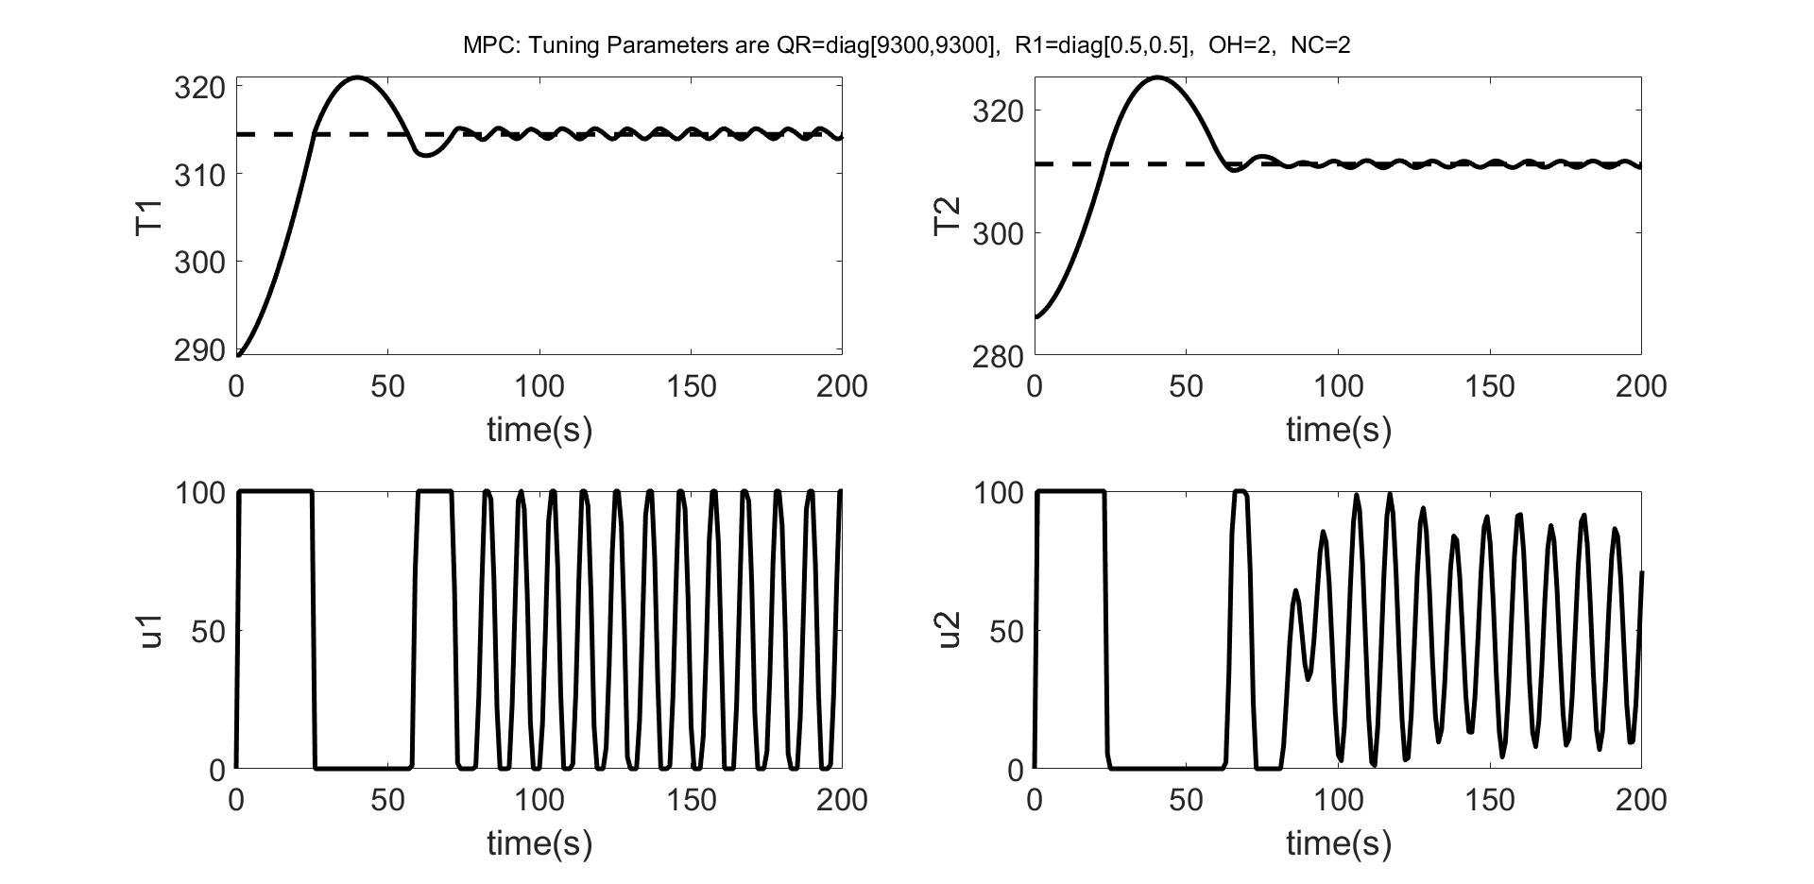

Closed loop Simulation Results
Online MPC
mp-MPC
Online MPC and mp-MPC results match.

Slide 20
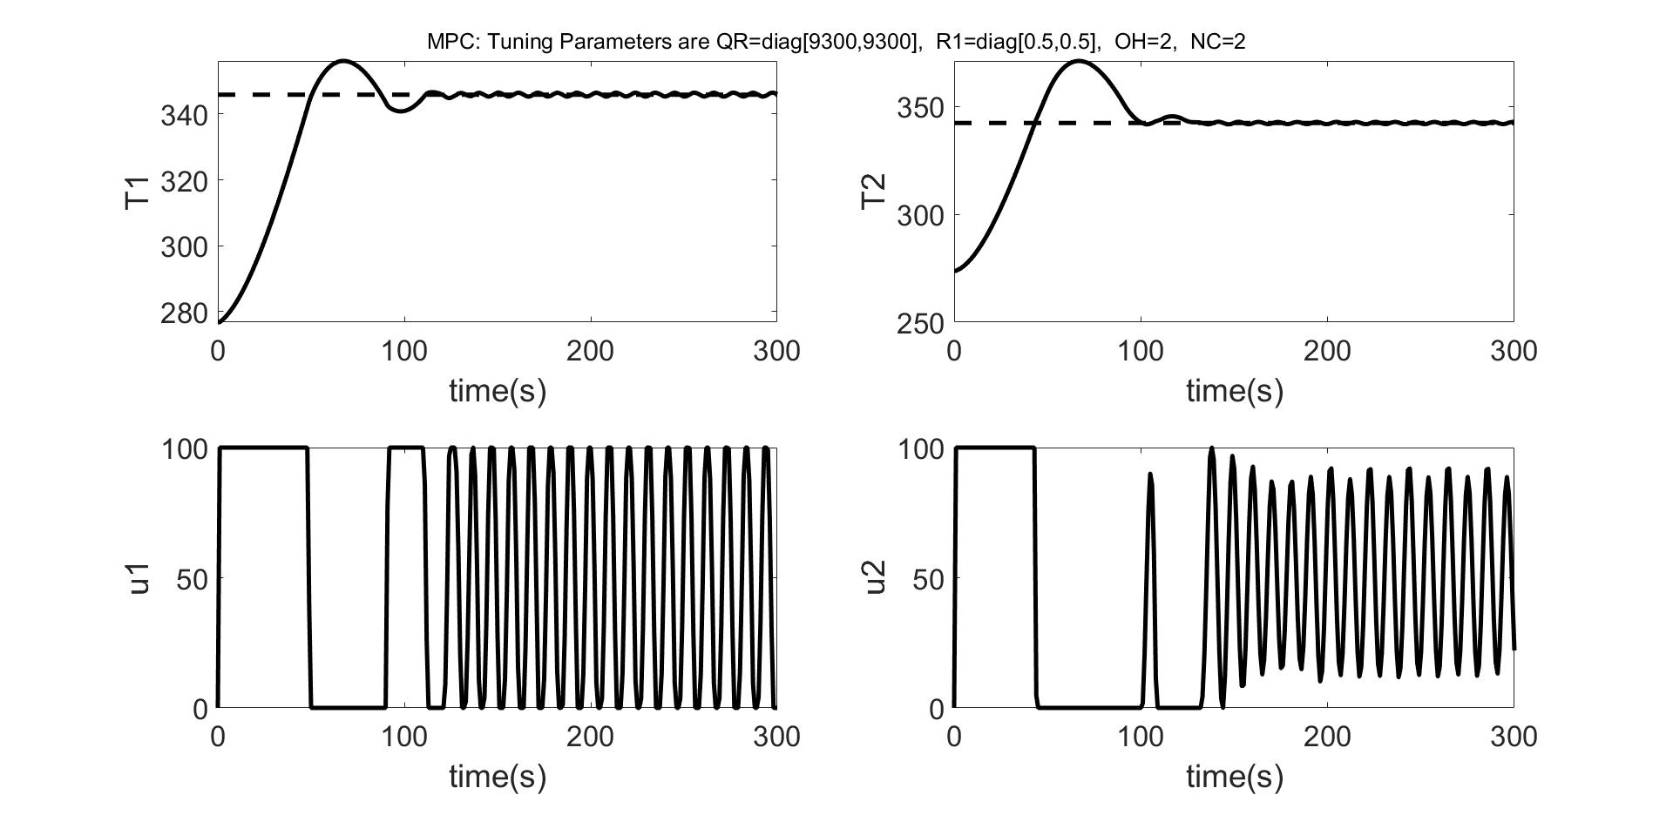

Closed Loop Simulation Results
Online MPC
mp-MPC
Online MPC and mp-MPC results match.

Slide 21
Conclusions and Future Work
Understanding of following algorithms:
LP|LP BLPP problems.
Multiparametric Linear Programming Problems (mp-LP)
Multiparametric Quadratic Programming Problems (mp-QP)
Comfortable in solving online MPC and mp-MPC.
BLPP formulation for TClab.
Objective is to get better set point tracking subject to minimisation of manipulated variables (u₁ and u₂) in the inner level.
BLPP formulation for building system
Objective is to minimise pollution concentration subject to thermal comfort of the occupants.
The formulation is difficult as it involves non-linearity in its formulation.
After bilevel has been successfully deployed on TCLab we can extend that to understand complex systems.

Slide 22
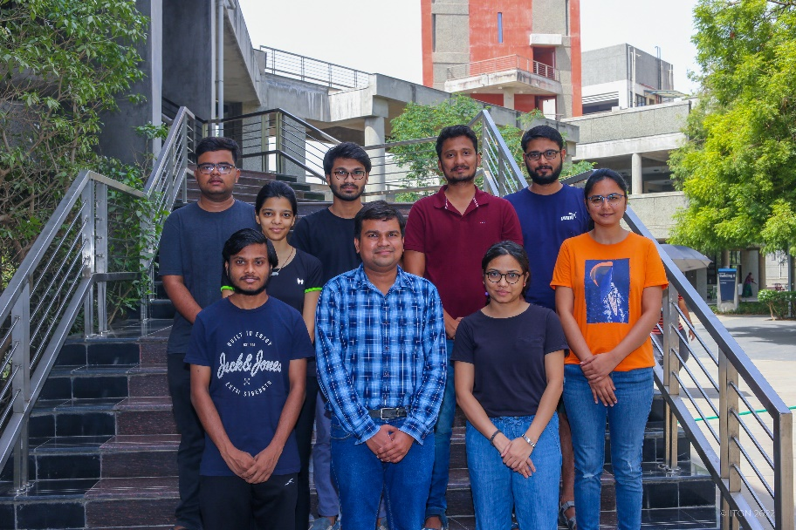
Acknowledgement
I am thankful to the Post-doc in our research group Dr. Radhe Saini for his guidance during my course project.
I am also thankful to Prof. Hari Ganesh research group
members for their support.
Thank You!

